Slide 1
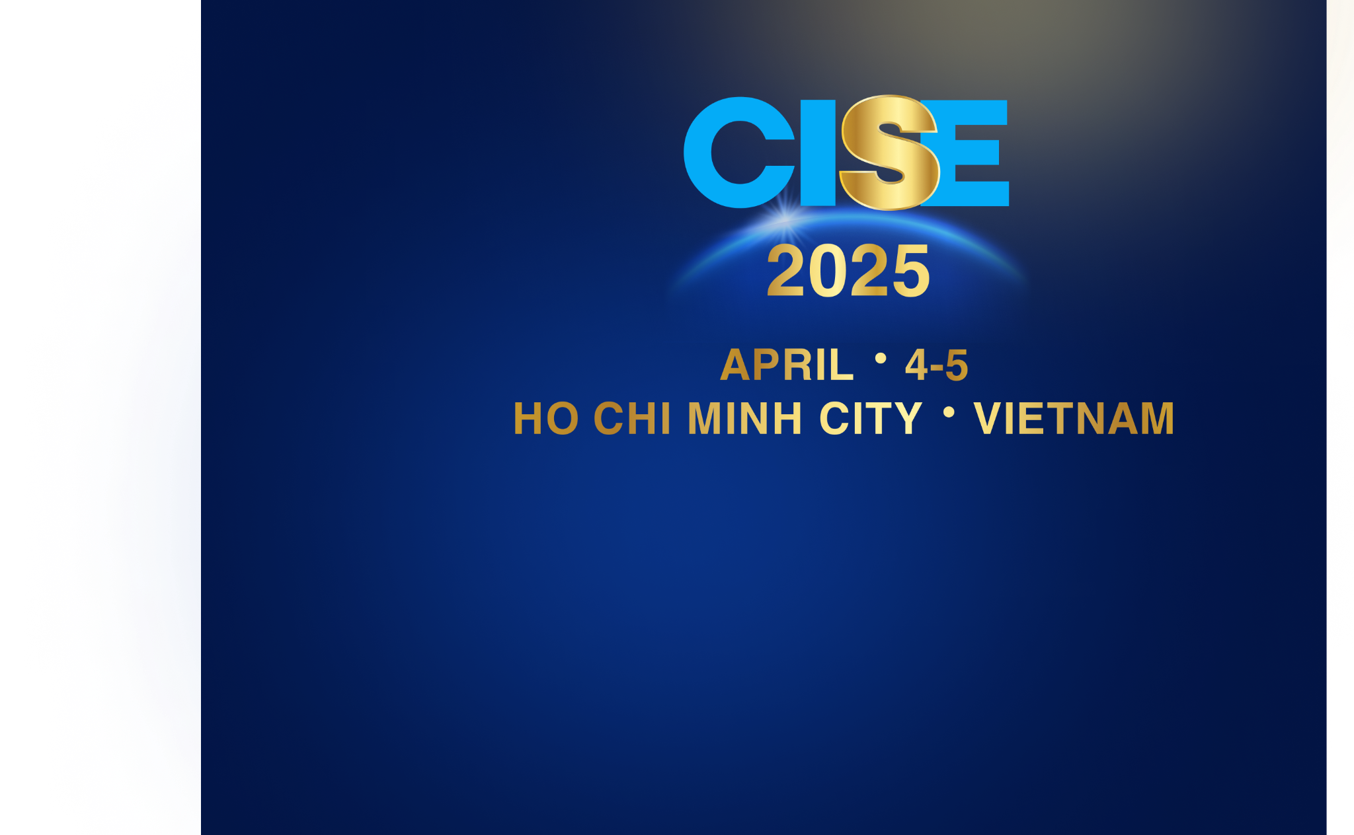

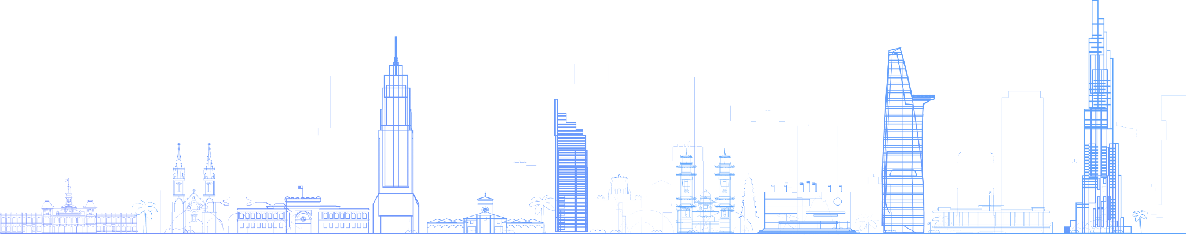

POSTER TITLE GOES HERE, CONTAINING STRICTLY
ONLY THE ESSENTIAL NUMBER OF WORDS...
Author’s Name/s Goes Here¹, Author’s Name/s Goes Here²
1: Organization(s) Goes Here; 2: Organization(s) Goes Here
Introduction
First…
Check the specifications of size and orientation, before you start your poster eg. maximum poster size; landscape, portrait or square.
The page size of this poster template is A0 (84x119cm), landscape (horizontal) format. Bear in mind you do not need to fill up the whole space allocated. Do not make your poster bigger than necessary just to fill that given size.
Captions to be set in Times or Times New Roman or equivalent, italic, between 18 and 24 points. Left aligned if it refers to a figure on its left. Caption starts right at the top edge of the picture (graph or photo).
Notes about graphs…
For simple graphs use MS Excel, or do the graph directly in PowerPoint.
Graphs done in a scientific graphing programs (eg. Sigma Plot, Prism, SPSS, Statistica) should be saved as JPEG or TIFF if possible.
Captions to be set in Times or Times New Roman or equivalent, italic, 18 to 24 points, to the length of the column in case a figure takes more than 2/3 of column width.
Captions to be set in Times or Times New Roman or equivalent, italic, between 18 and 24 points. Right aligned if it refers to a figure on its right. Caption starts right at the top edge of the picture (graph or photo).
Aim
How to use this poster template…
Simply highlight this text and replace it by typing in your own text, or copy and paste your text from a MS Word document or a PowerPoint slide presentation.
The body text / font size should be between 24 and 32 points. Arial, Helvetica or equivalent.
Keep body text left-aligned, do not justify text.
The colour of the text, title and poster background can be changed to the colour of your choice.
Results
Importing / inserting files…
Images such as photographs, graphs, diagrams, logos, etc, can be added to the poster.
To insert scanned images into your poster, go through the menus as follows: Insert / Picture / From File… then find the file on your computer, select it, and press OK.
The best type of image files to insert are JPEG or TIFF, JPEG is the preferred format.
Be aware of the image size you are importing. The average colour photo (13 x 18cm at 180dpi) would be about 3Mb (1Mb for B/W greyscale).
Do not use images from the web as their resolution is often too low for printing.
Method
Tips for making a successful poster…
Re-write your paper into poster format ie.
Simplify everything, avoid data overkill.
Headings of more than 6 words should be in upper and lower case, not all capitals.
Never do whole sentences in capitals or underline to stress your point, use bold characters instead.
When laying out your poster leave breathing space around you text. Don’t overcrowd your poster.
Try using photographs or coloured graphs. Avoid long numerical tables.
Spell check and get someone else to proof-read.
Captions to be set in Times or Times New Roman or equivalent, italic, between 18 and 24 points. Left aligned if it refers to a figure on its left. Caption starts right at the top edge of the picture
(graph or photo).
Conclusion
If you need any further assistance please contact:
CISE 2025 Conference Organizers
Phone: 0932 776 676
Email: cise2025.bdh@gmail.com
Web: https://cise2025.org
Acknowledgements
Just highlight this text and replace with your own text. Replace this with your text.
Captions to be set in Times or Times New Roman or equivalent, italic, 18 to 24 points, to the length of the column in case a figure takes more than 2/3 of column width.

Slide 2

POSTER TITLE GOES HERE, CONTAINING STRICTLY
ONLY THE ESSENTIAL NUMBER OF WORDS...
Author’s Name/s Goes Here¹, Author’s Name/s Goes Here²
1: Organization(s) Goes Here; 2: Organization(s) Goes Here
Introduction
First…
Check the specifications of size and orientation, before you start your poster eg. maximum poster size; landscape, portrait or square.
The page size of this poster template is A0 (84x119cm), landscape (horizontal) format. Bear in mind you do not need to fill up the whole space allocated. Do not make your poster bigger than necessary just to fill that given size.
Captions to be set in Times or Times New Roman or equivalent, italic, between 18 and 24 points. Left aligned if it refers to a figure on its left. Caption starts right at the top edge of the picture (graph or photo).
Notes about graphs…
For simple graphs use MS Excel, or do the graph directly in PowerPoint.
Graphs done in a scientific graphing programs (eg. Sigma Plot, Prism, SPSS, Statistica) should be saved as JPEG or TIFF if possible.
Captions to be set in Times or Times New Roman or equivalent, italic, between 18 and 24 points. Right aligned if it refers to a figure on its right. Caption starts right at the top edge of the picture (graph or photo).
Captions to be set in Times or Times New Roman or equivalent, italic, 18 to 24 points, to the length of the column in case a figure takes more than 2/3 of column width.
Aim
How to use this poster template…
Simply highlight this text and replace it by typing in your own text, or copy and paste your text from a MS Word document or a PowerPoint slide presentation.
The body text / font size should be between 24 and 32 points. Arial, Helvetica or equivalent.
Keep body text left-aligned, do not justify text.
The colour of the text, title and poster background can be changed to the colour of your choice.
Results
Importing / inserting files…
Images such as photographs, graphs, diagrams, logos, etc, can be added to the poster.
To insert scanned images into your poster, go through the menus as follows: Insert / Picture / From File… then find the file on your computer, select it, and press OK.
The best type of image files to insert are JPEG or TIFF, JPEG is the preferred format.
Be aware of the image size you are importing. The average colour photo (13 x 18cm at 180dpi) would be about 3Mb (1Mb for B/W greyscale).
Do not use images from the web as their resolution is often too low for printing.
Method
Tips for making a successful poster…
Re-write your paper into poster format ie.
Simplify everything, avoid data overkill.
Headings of more than 6 words should be in upper and lower case, not all capitals.
Never do whole sentences in capitals or underline to stress your point, use bold characters instead.
When laying out your poster leave breathing space around you text. Don’t overcrowd your poster.
Try using photographs or coloured graphs. Avoid long numerical tables.
Spell check and get someone else to proof-read.
Captions to be set in Times or Times New Roman or equivalent, italic, between 18 and 24 points. Left aligned if it refers to a figure on its left. Caption starts right at the top edge of the picture
(graph or photo).
Conclusion
If you need any further assistance please contact:
CISE 2025 Conference Organizers
Phone: 0932 776 676
Email: cise2025.bdh@gmail.com
Web: https://cise2025.org
Acknowledgements
Just highlight this text and replace with your own text. Replace this with your text.
Captions to be set in Times or Times New Roman or equivalent, italic, 18 to 24 points, to the length of the column in case a figure takes more than 2/3 of column width.

